Slide 1


Reproducible computational workflows

Slide 2
What I want you to know
Why reproducible workflows are important
What is a reproducible workflow
What is literate programing
Tools for reproducible workflow to accomplish FAIR data
Rules for reproducible workflow
Sandve et al. 2013 – Ten Simple Rules

Slide 3
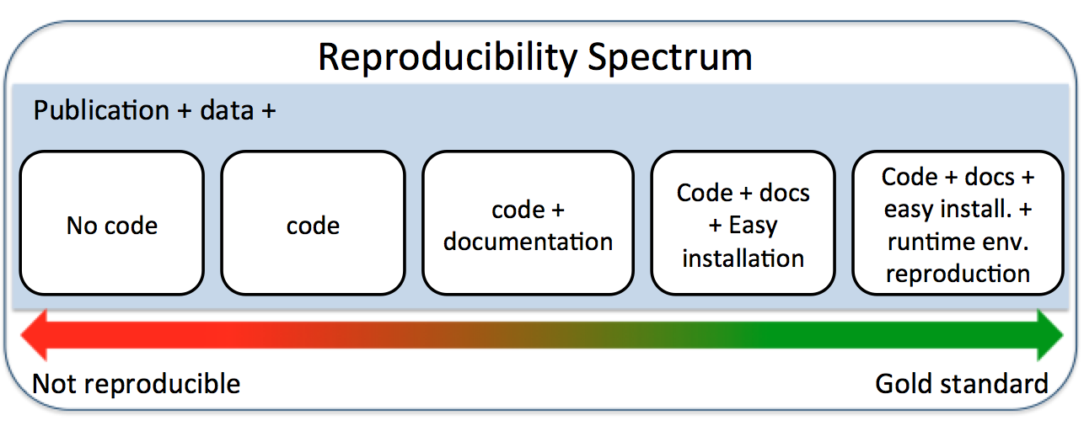
https://towardsdatascience.com/scientific-data-analysis-pipelines-and-reproducibility-75ff9df5b4c5

Slide 4
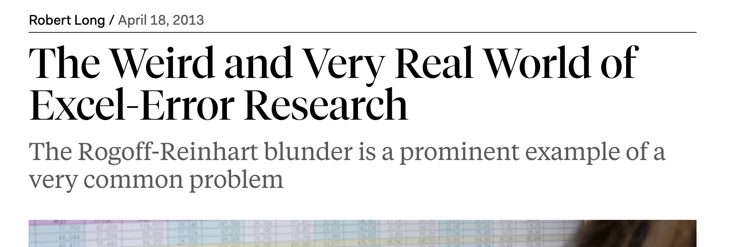
Kenneth Rogoff and Carmen Reinhart (Harvard): “Growth in a Time of Debt”
Thomas Herndon at Univ of Massachusetts Amherst tried to reproduce these results
Found major formula error - original paper excluded key data from Canada, New Zealand, and Australia
US policy implications

Slide 5
Ashley Shade – EDDEMAME COURSE 2018 Kellogg Biological Station, MSU

Slide 6
Ashley Shade – EDDEMAME COURSE 2018 Kellogg Biological Station, MSU

Slide 7
Ashley Shade – EDDEMAME COURSE 2018 Kellogg Biological Station, MSU

Slide 8
Ashley Shade – EDDEMAME COURSE 2018 Kellogg Biological Station, MSU

Slide 9
Computers do not know any better!
Workflows must be complete!
Peanut butter and jelly robot
https://www.youtube.com/watch?v=leBEFaVHllE
Ashley Shade – EDDEMAME COURSE 2018 Kellogg Biological Station, MSU

Slide 10
Ashley Shade – EDDEMAME COURSE 2018 Kellogg Biological Station, MSU

Slide 11
Literate programing = Text + code + figures
Ashley Shade – EDDEMAME COURSE 2018 Kellogg Biological Station, MSU

Slide 12
Tools

Slide 13

Git
Tool to manage source code
own vocabulary
work with it on command line or through something else – “point and click”
GitHub
Version control
A public repository for code
Collaboration
Cloud based
Free (to a point)
What part of FAIR?

Slide 14
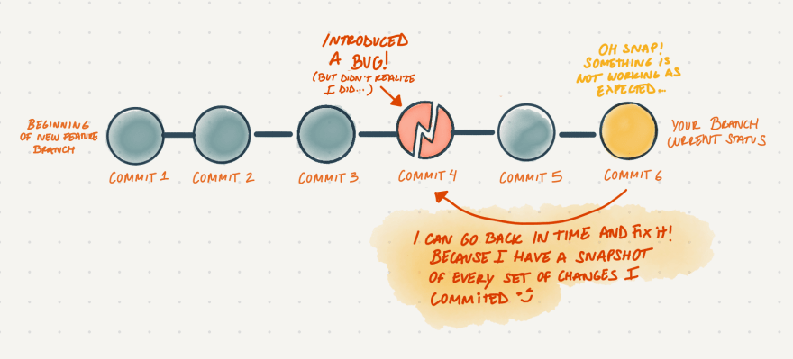
Git and version contol
https://dev.to/milu_franz/git-explained-the-basics-igc

Slide 15
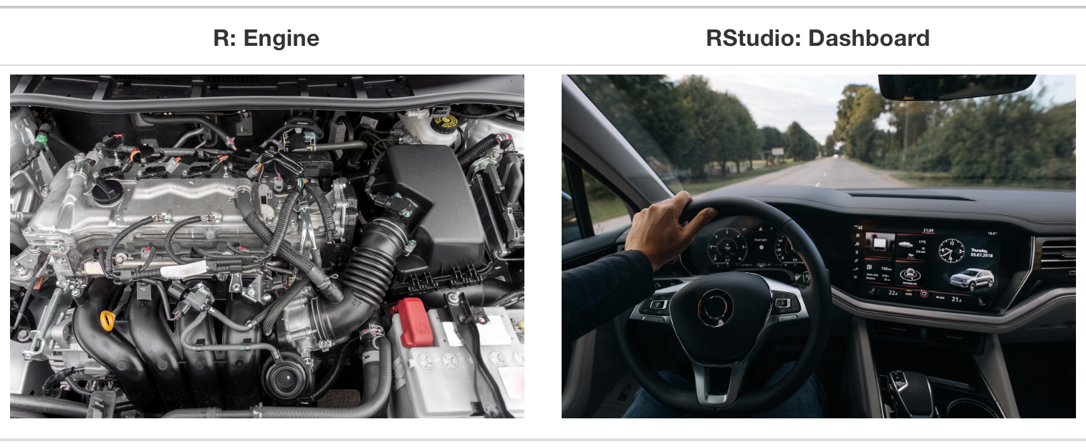
What part of FAIR?
https://moderndive.com/1-getting-started.html

Slide 16
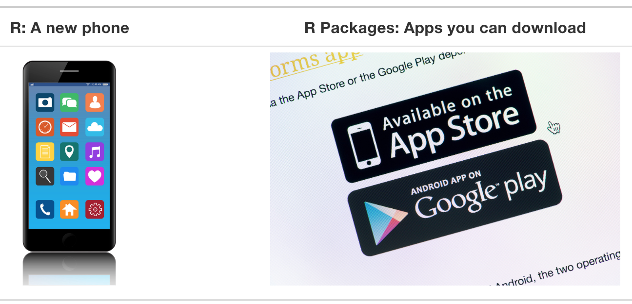
https://moderndive.com/1-getting-started.html

Slide 17
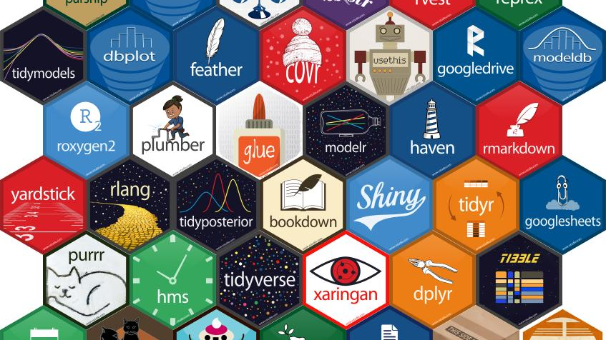

Slide 18

Release in 2014
Can combine R, text & images into one document
Easily convert between word, pdf, HTML (web)

Slide 19
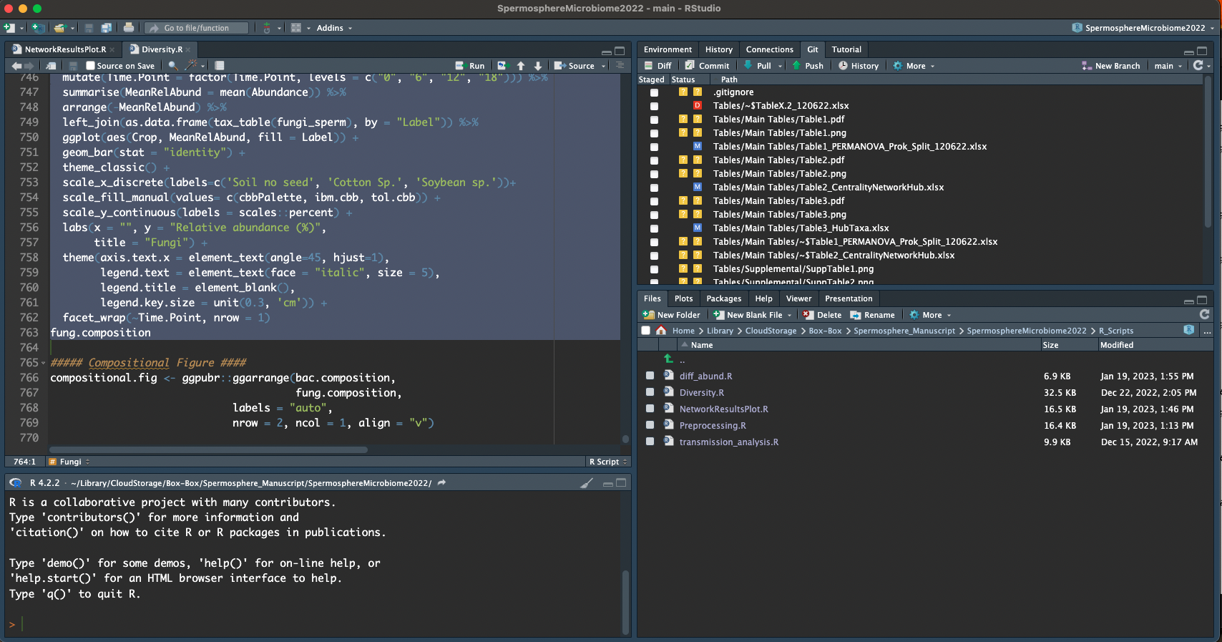
Rstudio – Brings it all together

Slide 20
Good example reproducible workflows
Awesome!
https://github.com/Chilverslab/Rojas_Survey_Phytopath_2016
Better!
https://github.com/noelzach/Community_Fungicide_Sensitivity
Good!
https://github.com/Noel-Lab-Auburn/SpermosphereMicrobiome2022/settings
Eh… its ok.
https://github.com/noelzach/FungicidePulseDisturbance

